Slide 1
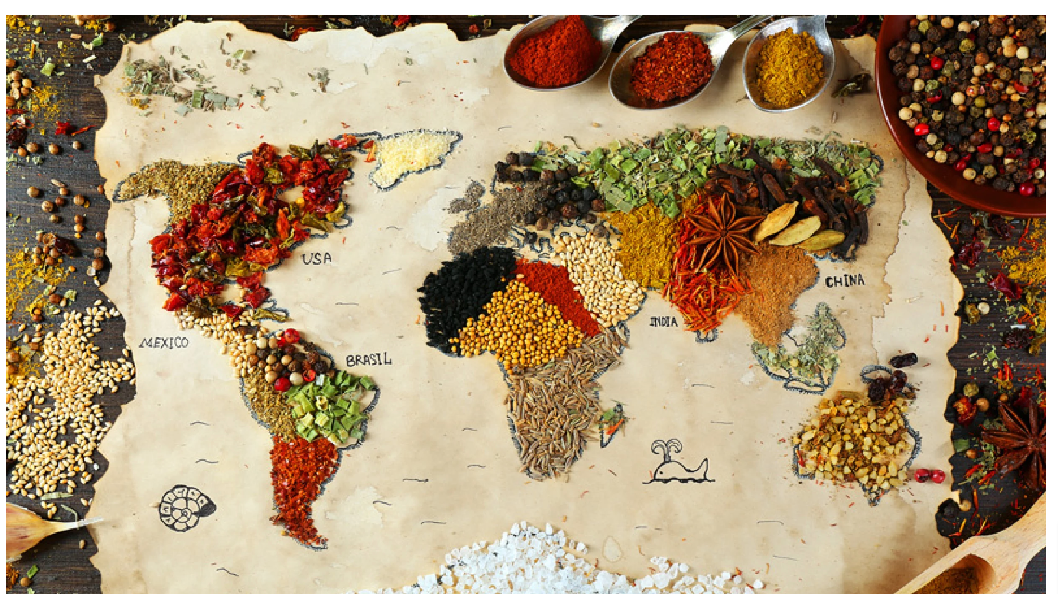
Multicultural Menu

Slide 2
COMP 170 – Final Project Presentation
Team Name: Team 3
Team Members:
Alberta Ayitey-
Jeremiah Lateef-
Shwetha Vaidyanathan-

Slide 3
Final Project Overall Idea
Name of the Project: Multicultural Menu
How the Project works:
This project aims to present a personalized menu with dishes from Asia, Africa, Caribbean and Europe. The user will interact with the program by answering questions to understand their choice of region, dietary preference, and allergies if any. The program will then provide an itemized list of menu items. The program was made to celebrate the diversity of food across the world, and provide knowledge on various dishes.

Slide 4
Overall Organization
Class/program structure-
There is one main java file, along with other text files and a JSON File.
What do they do-
The JSON File has the arrays of all the menu items grouped based on the region, dietary preference, and allergies. The main java file will extract the content from this file. There are five methods in the main program.
Any Project text files and how they’re used-
There are five text files which contain content for the various questions, and statements.

Slide 5
Project Testing
How did you test your Project?
We tested the project by ourselves, and then got feedback from family and friends, to gauge if the various questions resonated with them.
What kinds of tests did you run?
The very first test we ran after writing out the methods was to prepare for the contingencies when the user
Who was responsible for what aspects of Project testing?

Slide 6
Learning Beyond Class
We learnt to use JSON, especially in terms of adding the data there, and extracting it to the main Java program. We used

Slide 7
Biggest Challenges

Slide 8
Project Demo

